Slide 1
Updates 8/12/20
Akash Levy

Slide 2
Overview
Sweep plot for FPPV
Sweep plots for VWL and VBL
Retention distribution plots
Retention BER plot
ISPP optimization results
SDCFC optimization results
ISPP/FPPV evaluation on chip 1

Slide 3
Sweep Plots
Slope comparisons for different knobs, and FPPV results

Slide 4
Sweep Plots: FPPV VWL Chip 1

Slide 5
Sweep Plots: SET VWL

Slide 6
Sweep Plots: RESET VWL

Slide 7
Sweep Plots: SET VBL

Slide 8
Sweep Plots: RESET VSL

Slide 9
3bpc Algorithms
Optimization and experimental results

Slide 10
Resistance Ranges
 | Rmin | Rmax | Rwmin | Rwmax
Range 0 | N/A | 4.3k | N/A | 4.2k
Range 1 | 4.38k | 4.75k | 4.54k | 4.58k
Range 2 | 4.84k | 5.3k | 5.04k | 5.09k
Range 3 | 5.42k | 6.01k | 5.67k | 5.73k
Range 4 | 6.16k | 6.99k | 6.51k | 6.59k
Range 5 | 7.19k | 8.9k | 7.71k | 7.87k
Range 6 | 9.2k | 25k | 11.42k | 11.93k
Range 7 | 20k | N/A | 80k | N/A

Slide 11
ISPP Optimization Results

Slide 12
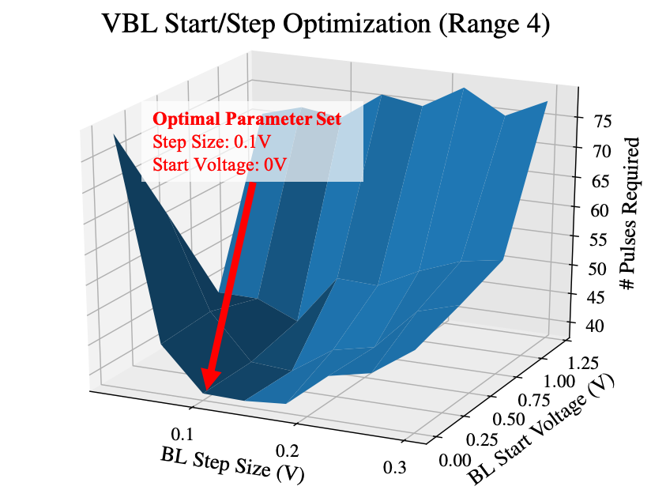
VBL Step Size Optimization

Slide 13
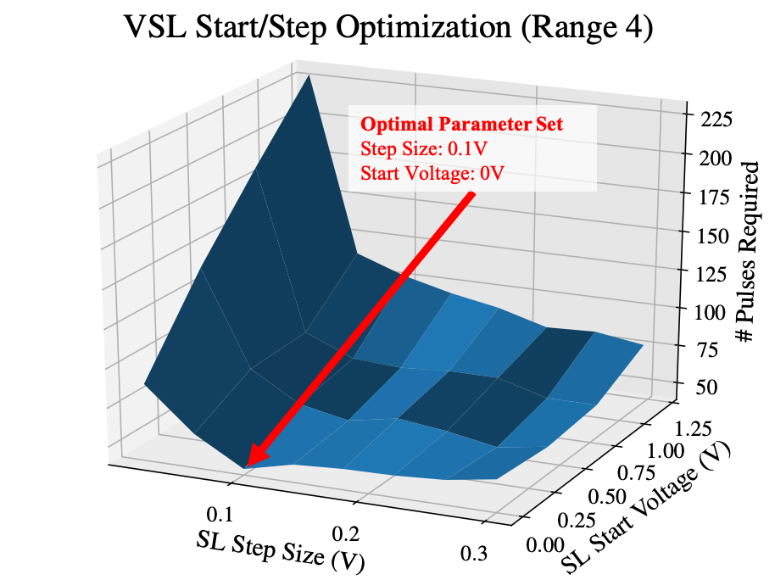
VSL Step Size Optimization

Slide 14
Optimization Parameters
 | VBL Start (V) | VBL Step (V) | VSL Start (V) | VSL Step (V)
Range 0 | 2 | 0.3 | N/A | N/A
Range 1 | 0 | 0.14 | 0 | 0.14
Range 2 | 0 | 0.1 | 0 | 0.1
Range 3 | 0 | 0.1 | 0 | 0.1
Range 4 | 0 | 0.1 | 0 | 0.1
Range 5 | 0 | 0.06 | 0 | 0.06
Range 6 | 0 | 0.06 | 0 | 0.1

Slide 15
Algorithm evaluation on 4 WLs: chip 1

Slide 16
Algorithm evaluation on 4 WLs: chip 2

Slide 17
3bpc algorithm evaluation on 4 WLs
Chip # | Cycles | SDCFC | ISPP | FPPV
1 | 300 | 36.44 | 86.10 | >90
2 | 300 | 35.88 | >90 | >90
1 | 8k | 35.19 | >90 | >90
2 | 8k | TODO | >90 | >90
Notes:
92.95 for chip 2 ISPP

Slide 18
2bpc Algorithms
Optimization and experimental results

Slide 19
Resistance Ranges
 | Rmin | Rmax | Rwmin | Rwmax
Range 0 | N/A | 5.10k | N/A | 5.00k
Range 1 | 5.38k | 6.48k | 5.77k | 6.01k
Range 2 | 6.93k | 12.00k | 8.51k | 9.31k
Range 3 | 20.00k | N/A | 80k | N/A

Slide 20
ISPP Optimization Results

Slide 21
VBL Step Size Optimization

Slide 22
VSL Step Size Optimization

Slide 23
Optimization Parameters
 | VBL Start (V) | VBL Step (V) | VSL Start (V) | VSL Step (V)
Range 0 | 2 | 0.3 | N/A | N/A
Range 1 | 0.6 | 0.18 | 0.6 | 0.26
Range 2 | 0.8 | 0.1 | 0.6 | 0.34

Slide 24
Algorithm evaluation on 4 WLs: chip 1

Slide 25
Algorithm evaluation on 4 WLs: chip 2

Slide 26
2bpc algorithm evaluation on 4 WLs
Chip # | Cycles | SDCFC | ISPP | FPPV
1 | 300 | 8.52 | 20.51 | 15.75
2 | 300 | 8.50 | 21.62 | 16.83
1 | 8k | 9.56 | >25 | >25
2 | 8k | 9.39 | >25 | >25

Slide 27
Retention
Distributions (empirical and predicted)

Slide 28
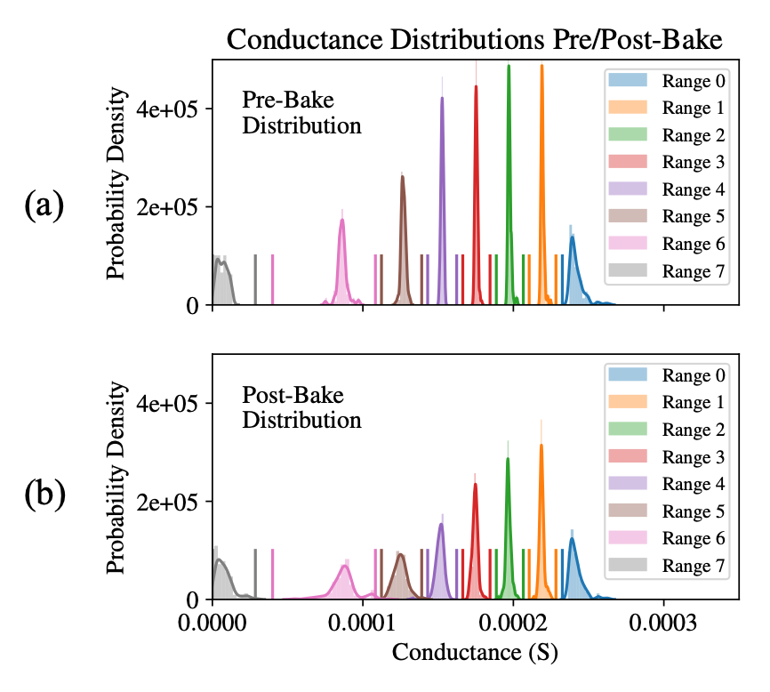
Combined Distribution Plot

Slide 29
Retention model plot

Slide 30
Retention BER plot

Slide 31
Comparison Table
 | Array Level? | Bits-per-cell | # of Cells Measured | Ranges allocated efficiently? | Endurance/Retention
This work | Yes | 3 | 16,384 | Yes | Endurance Retention: array-level, high-temp
TED Binh | Yes | 3 | 7,746 | Yes | Endurance
(1) | No | 2 | Single cell | No | Endurance Retention: single-cell, high-temp
(2) | No | 3 | Single cell | No | Endurance Retention: single-cell, high-temp
(3) | No | 3 | Single cell | No | Endurance Retention: single-cell, low-temp
(4) | No | 3 | Single cell | No | Retention: single-cell, low-temp
(5) | No | 2 | Single cell | No | None
(6) | No | 4 | Single cell | No | Retention: single-cell, low-temp
(7) | No | 2 | 10 | No | Endurance
(8) | Yes | 2 | 4,096 | No | Endurance Retention: array-level, high-temp

Slide 32
Comparison References
Optimized Method for Low-Energy and Highly Reliable Multibit Operation in a HfO2-Based Resistive Switching Device
Fully “Erase-free” Multi-Bit Operation in HfO2‐Based Resistive Switching Device
A multi-level 40nm WOx resistive memory with excellent reliability
Demonstration of low power 3-bit multilevel cell characteristics in a TaOx-based RRAM by stack engineering
A novel program- verify algorithm for multi-bit operation in HfO2 RRAM
Four-bits-per-cell operation in an HfO2-based resistive switching device
Characteristics of multilevel storage and switching dynamics in resistive switching cell of Al2 O3 /HfO2 /Al2 O3 sand- wich structure
Toward Reliable Multi-Level Operation in RRAM Arrays: Improving Post-Algorithm Stability and Assessing Endurance/Data Retention

Slide 33
Backup
Things we will show only if reviewers or co-authors ask

Slide 34
3bpc Pre-Optimization Parameters
 | VBL Start (V): Seed | VBL Step (V): Seed | VSL Start (V) | VSL Step (V)
Range 0 | 0.4 | 0.04 | N/A | N/A
Range 1 | 0.4 | 0.04 | 0.6 | 0.18
Range 2 | 0.4 | 0.04 | 0.2 | 0.22
Range 3 | 0.4 | 0.04 | 0.4 | 0.14
Range 4 | 0.4 | 0.04 | 0.4 | 0.14
Range 5 | 0.4 | 0.04 | 0.4 | 0.14
Range 6 | 0.4 | 0.04 | 0.4 | 0.14

Slide 35
2bpc Pre-Optimization Parameters
 | VBL Start (V): Seed | VBL Step (V): Seed | VSL Start (V) | VSL Step (V)
Range 0 | 2 | 0.3 | N/A | N/A
Range 1 | 0 | 0.04 | 0 | 0.16
Range 2 | 0 | 0.04 | 0 | 0.1

Slide 36
BER Plot at 100 Pulses

Slide 37
Retention BER plot full

Slide 38
Combined Pre/Post-Bake Distribution Plot
(a)
(b)

Slide 39
VBL Optimization
Optimal Parameter Set
Step Size: 0.1V
Start Voltage: 0V

Slide 40
VSL Optimization 1

Slide 41
VSL Optimization 2
Optimal Parameter Set
Step Size: 0.1V
Start Voltage: 0V

Slide 42
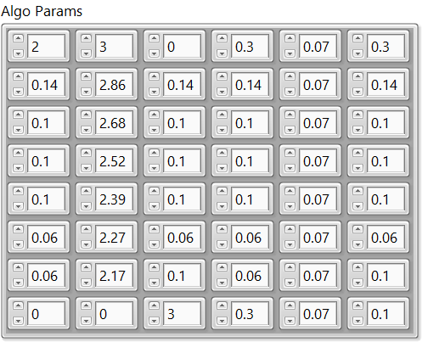
Algorithm Parameters

